Slide 1
SELECTION SORT
Group 4
Pablo, Lester
Agustin, Mary Joy
Sabinosa, Reccalyn
Valiente, Jenniferlyn

Slide 2
Selection Sort
Sorting array elements
In selection sort, we search for the lowest element and arrange it to the proper location.
We swap the current element with the next lowest number.
For example, we have this array elements. Starting from 0-7 index (8 elements)
2 | 4 | 5 | 3 | 1 | 8 | 10 | 0
Elements
0 | 1 | 2 | 3 | 4 | 5 | 6 | 7
Index
The element of index 0 is the minimum value.
minVal = 2
The loop will check the next element, which is the element 4.
Is 4 < 2?
IF true, minVal = 4
False, minVal = 2

Slide 3
2 | 4 | 5 | 3 | 1 | 8 | 10 | 0
Elements
0 | 1 | 2 | 3 | 4 | 5 | 6 | 7
Index
The element of index 0 is the minimum value.
minVal = 2
The loop will check the next element, which is the element 4.
Is 4 < 2?
IF true, minVal = 4
False, minVal = 2
The loop will check all the elements and compare the elements to the current minimum value.
For example, we name the elements as elem.
IF (elem[] < minVal)
minVal = elem;
The loop will continue to loop until all the elements are sorted from the lowest to the highest to lowest.
2 | 4 | 5 | 3 | 1 | 8 | 10 | 0
0 | 1 | 2 | 3 | 4 | 5 | 8 | 10

Slide 4
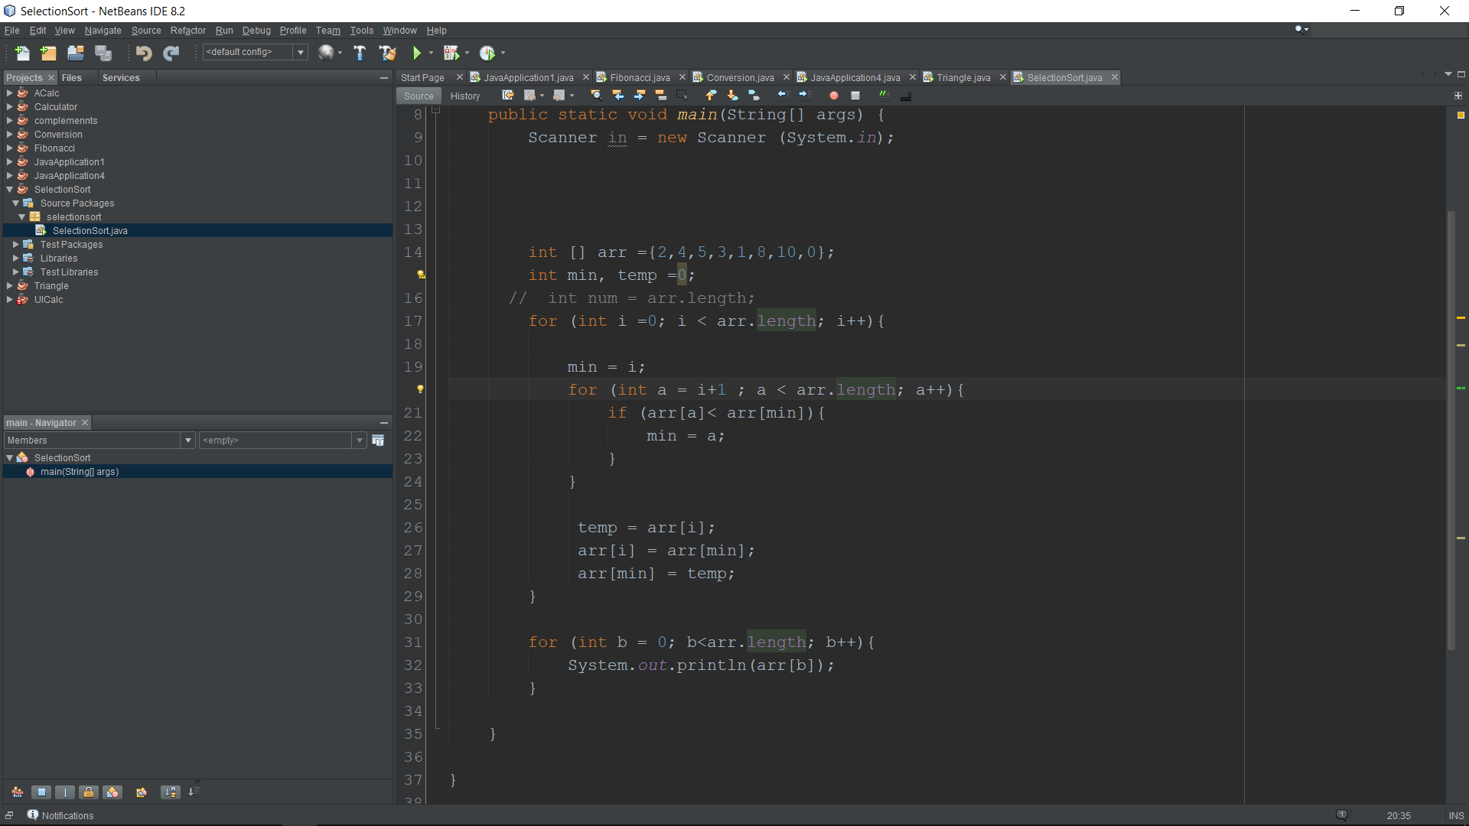
Array
int min = minimum value
int temp = 0; //temporary value
//int num will be equal to length of array.
// to be used in descending sort only
Loop from 0 to array length – 1
min will take the value of i
Loop from 1 to array length - 1
If the next element is less than the current minimum value, the min value will be equal to a.

Slide 5
//temp is temporary value
Temporary value is equal to arr[i]
then arr[i] is equal to arr[min]
then arr[min] will be equal to temp
Will display the output

Slide 6
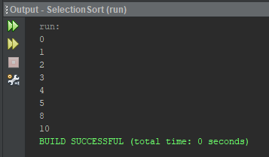
ASCENDING

Slide 7
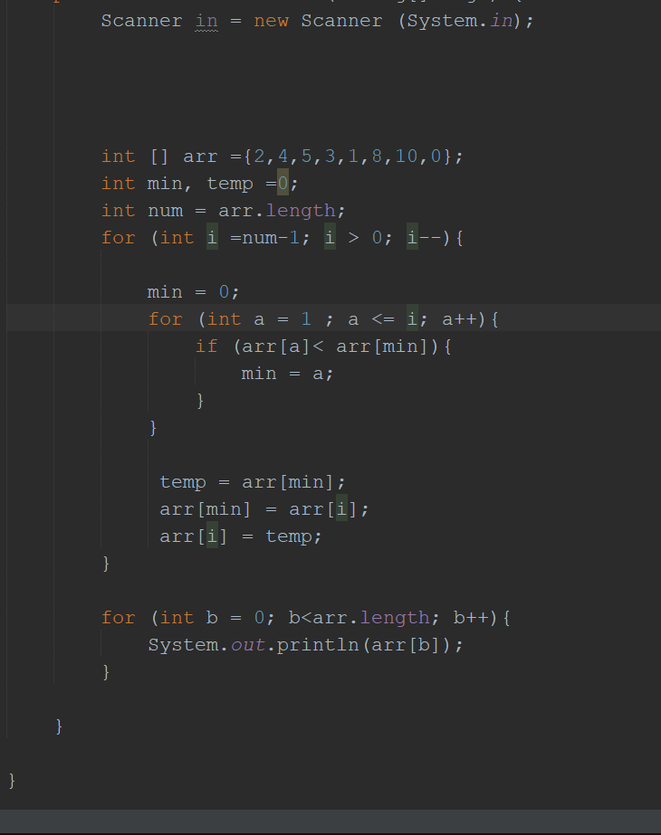

DESCENDING

